Slide 1
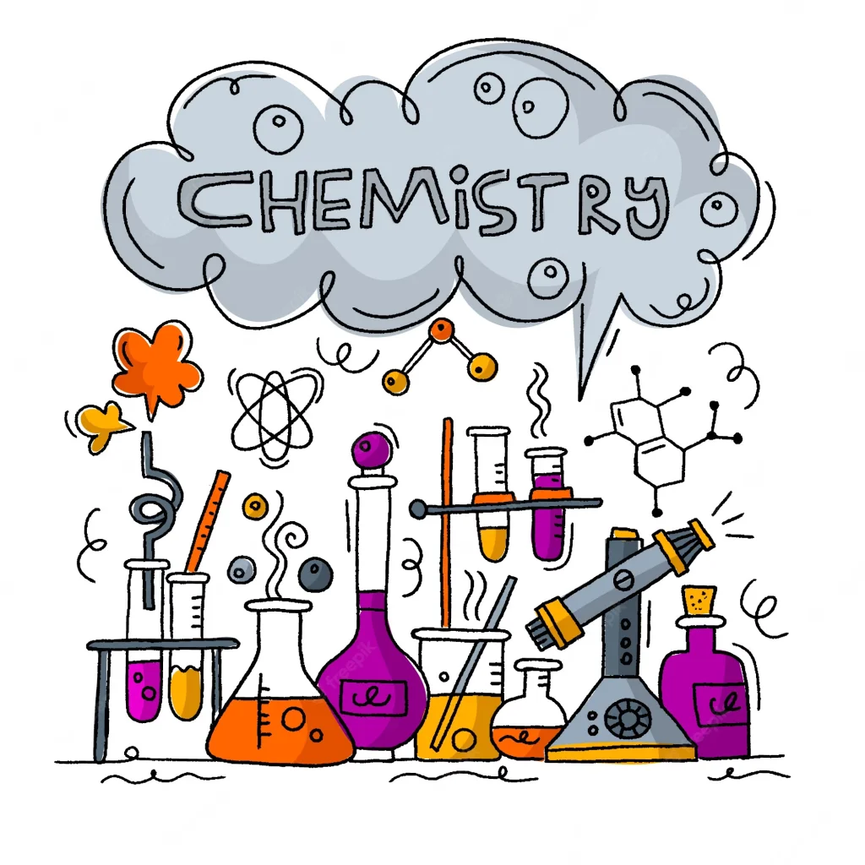
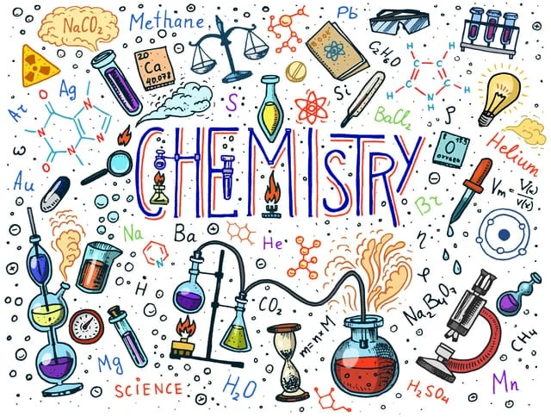
Concepts of Chemistry

Slide 2
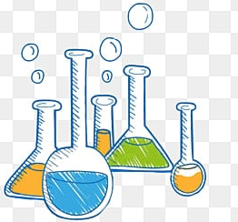
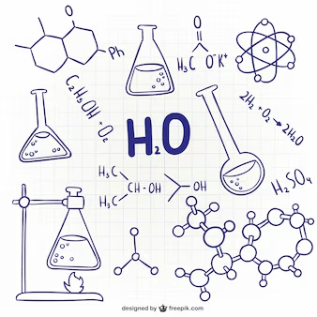
What is Chemistry?
Chemistry is the branch of science that studies the composition, structure, properties, and changes of matter. It explores how different substances interact, combine, and transform through chemical reactions. Chemistry helps us understand the building blocks of the universe, such as atoms and molecules, and their roles in everything from biological processes to technological innovations.
Chemistry is often referred to as the "central science" because it connects physics with other natural sciences like biology and geology.

Slide 3
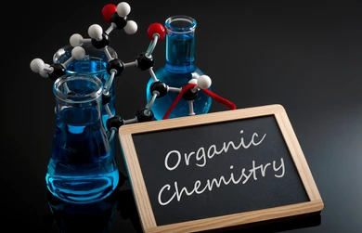
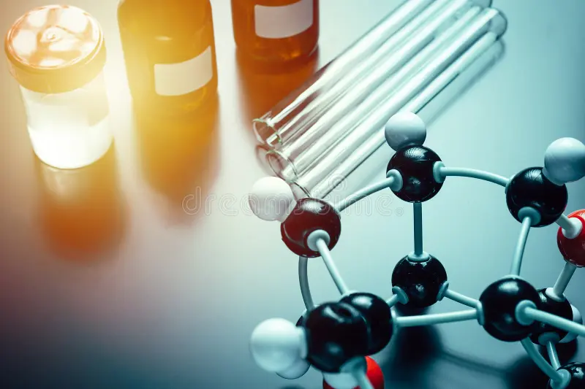
Organic Chemistry
Organic Chemistry is that branch of Chemistry that deals with the Carbon and its organic compounds.
It includes various topics such as:
Carbohydrates, Proteins, and Lipids
Amines and Nitrogen Compounds
Carboxylic Acids and Derivatives
Aldehydes and Ketones
Alcohols, Phenols, and Ethers
Aromatic Compounds
Alkanes, Alkenes, and Alkynes
Reaction Mechanisms

Slide 4
Carbohydrates, Proteins, and Lipids
Carbohydrates: Classified into monosaccharides (e.g., glucose), disaccharides (e.g., sucrose), and polysaccharides (e.g., starch, cellulose).
Monosaccharides: Simple sugars with the formula (CH₂O)ₙ; glucose is the most common, an aldohexose.
Disaccharides: Formed by a glycosidic bond between two monosaccharides (e.g., glucose + fructose = sucrose).
Polysaccharides: Complex carbohydrates like starch (energy storage in plants) and glycogen (storage in animals).
Proteins: Polymers of amino acids linked by peptide bonds; they function as enzymes, hormones, and structural components.
Amino Acids: 20 standard amino acids, categorized into essential (cannot be synthesized by the body) and non-essential.
Protein Structure: Classified into primary (amino acid sequence), secondary (α-helix and β-sheet), tertiary (3D folding), and quaternary (multiple polypeptides).
Lipids: Fats and oils made of fatty acids and glycerol; they serve as energy storage and form cell membranes.
Fatty Acids: Saturated (no double bonds) and unsaturated (one or more double bonds); unsaturated fats are considered healthier.
Phospholipids: Key components of cell membranes, consisting of two fatty acids, glycerol, and a phosphate group.

Slide 5
Carboxylic Acids and Derivatives
Carboxylic acids contain a functional group –COOH (carboxyl group), where both the carbonyl (C=O) and hydroxyl (–OH) groups are attached to the same carbon atom.
Nomenclature: Carboxylic acids are named by replacing the "e" in the parent alkane name with "oic acid" (e.g., ethanoic acid).
Acidity: Carboxylic acids are more acidic than alcohols and phenols due to resonance stabilization of the carboxylate ion (RCOO–).
Preparation: Carboxylic acids can be prepared by oxidation of primary alcohols and aldehydes or by hydrolysis of nitriles.
Reactions: Carboxylic acids undergo nucleophilic acyl substitution, esterification, and decarboxylation.
Esterification: Carboxylic acids react with alcohols in the presence of an acid catalyst to form esters.
Acid Derivatives: Carboxylic acid derivatives include esters, acid chlorides, anhydrides, and amides.
Hydrolysis: Acid derivatives can be hydrolyzed back into carboxylic acids under acidic or basic conditions.
Decarboxylation: Carboxylic acids lose a CO₂ molecule when heated, forming alkanes in some cases.
Applications: Carboxylic acids and their derivatives are widely used in industries for the production of polymers, pharmaceuticals, and flavoring agents.

Slide 6
Aldehydes and Ketones
Structure: Aldehydes have the general formula R-CHO, and ketones have the formula R-CO-R', where R and R' are alkyl or aryl groups.
Nomenclature: Aldehydes are named by replacing the ‘-e’ of the parent alkane with ‘-al’, and ketones are named by replacing ‘-e’ with ‘-one’.
Preparation of Aldehydes: Oxidation of primary alcohols using mild oxidizing agents like PCC.
Preparation of Ketones: Oxidation of secondary alcohols or by the hydration of alkynes.
Physical Properties: Lower aldehydes and ketones are polar and have higher boiling points than hydrocarbons but lower than alcohols due to the absence of hydrogen bonding.
Reactivity: Aldehydes are generally more reactive than ketones due to steric and electronic effects.
Nucleophilic Addition Reactions: A characteristic reaction of aldehydes and ketones, where a nucleophile attacks the electrophilic carbonyl carbon.
Reduction: Aldehydes and ketones can be reduced to alcohols using reagents like LiAlH₄ or NaBH₄.
Oxidation: Aldehydes can be easily oxidized to carboxylic acids, while ketones are more resistant to oxidation.
Aldol Condensation: Aldehydes and ketones with α-hydrogens undergo aldol condensation to form β-hydroxy aldehydes or ketones, leading to further dehydration.

Slide 7
Alcohols, Phenols, and Ethers
Alcohols: Organic compounds containing one or more hydroxyl groups (-OH) attached to a saturated carbon atom.
Phenols: Compounds in which a hydroxyl group (-OH) is directly attached to a benzene ring.
Ethers: Organic compounds with an oxygen atom connected to two alkyl or aryl groups (R-O-R’).
Nomenclature: Alcohols are named by replacing the "-e" of the alkane with "-ol", while ethers are named by naming the alkyl groups followed by "ether."
Preparation of Alcohols: Alcohols can be prepared by hydration of alkenes, reduction of aldehydes, ketones, and carboxylic acids.
Acidity of Phenols: Phenols are more acidic than alcohols due to resonance stabilization of the phenoxide ion.
Dehydration of Alcohols: Alcohols undergo elimination (E1 or E2) to form alkenes when heated with concentrated acids like H₂SO₄.
Williamson Ether Synthesis: Ethers are synthesized by the reaction of an alkoxide ion with an alkyl halide (SN2 reaction).
Reactions of Alcohols: Alcohols can undergo oxidation to form aldehydes, ketones, or carboxylic acids depending on the oxidation conditions.
Cleavage of Ethers: Ethers are cleaved by concentrated acids like HBr or HI to form alkyl halides.

Slide 8
Alkanes, Alkenes, and Alkynes
Alkanes: Saturated hydrocarbons with single bonds (C–C) and general formula CₙH₂ₙ₊₂.
Alkenes: Unsaturated hydrocarbons with at least one double bond (C=C) and formula CₙH₂ₙ.
Alkynes: Unsaturated hydrocarbons with at least one triple bond (C≡C) and formula CₙH₂ₙ₋₂.
Nomenclature: Follows IUPAC rules for naming hydrocarbons with appropriate prefixes and suffixes.
Preparation of Alkanes: By Wurtz reaction, decarboxylation of carboxylic acids, and hydrogenation of alkenes/alkynes.
Preparation of Alkenes: Through dehydrohalogenation of alkyl halides and dehydration of alcohols.
Preparation of Alkynes: By dehalogenation of tetrahalides or dehydrohalogenation of dihalides.
Markovnikov’s Rule: Governs the addition of hydrogen halides to unsymmetrical alkenes.
Anti-Markovnikov Addition: Follows peroxide effect (Kharasch effect) in the addition of HBr to alkenes.

Slide 9


